Slide 1
Human Activity Detection with Smartphone Data
by Benjamin Stano

Slide 2
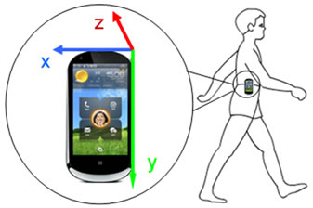
Activity Detection Using Smartphones
Predicts users action based on sensors
Smartphones have accelerometer, gyroscope standard
Smartphones ideal for HAD
Endless data
Countless uses

Slide 3
Practical Applications
HAD has many practical uses:
Biometric Security
Elderly and youth care
Industrial Manufacturing and Assisting
Daily Life and Fitness monitoring

Slide 4
Research Questions
Questions to answer:
Predict subject activity while using their smartphone
Many sensor inputs, which are important?
Many modeling types, which one is ideal?

Slide 5
Introducing the Data

Slide 6
Human Activity Recognition Using Smartphones
30 volunteers performing same 6 actions
Laying, Standing, Sitting, Walking, Walking Upstairs, and Walking Downstairs
Manually labeled as six actions
50 Hz intervals, or every 0.02 seconds
Data split: 70% training, 30% testing
7352 training instances, 2947 testing instances
561 features in total
Triaxial acceleration and estimated body acceleration
Triaxial angular momentum
source:
https://archive.ics.uci.edu/ml/datasets/human+activity+recognition+using+smartphones

Slide 7
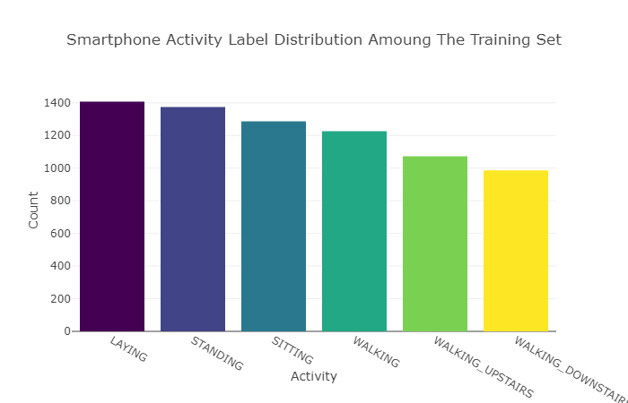
Is the Training Data Balanced?
Unbalanced training set leads to model error
Percentages relative to total counts
Outcome is balanced in the training set
19.1%
18.7%
17.5%
16.7%
14.6%
13.4%

Slide 8
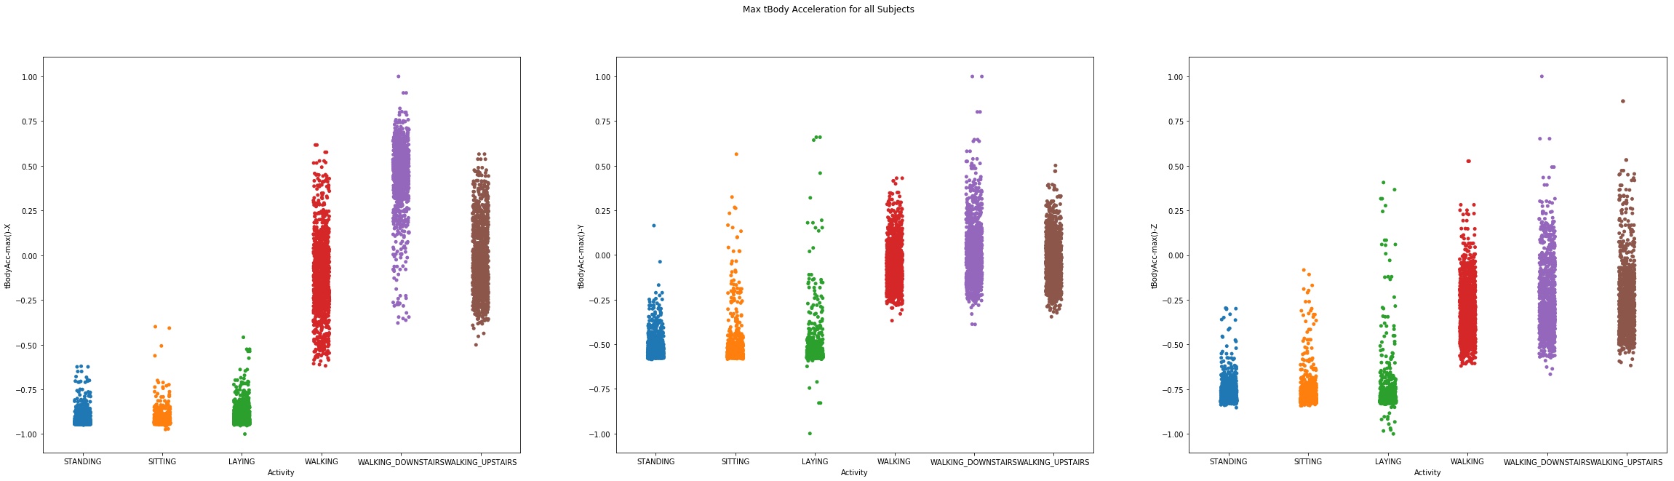
Passive vs. Active Activities
Plot shows max acceleration readings for each activity type
Passive: standing, sitting, laying
Very clustered
Active: walking, walking upstairs, walking downstairs
Much more variable
Max Acceleration X
Max Acceleration Y
Max Acceleration Z

Slide 9
Exploring Feature Sets

Slide 10
Exploring Different Feature Sizes
Find most efficient feature set
Many models easily overburdened
Outcome could go unexplained
HAD data rife with variance
Use Random Forest Classifier to test different feature sets
Easy to train and adaptable
Gives feature importance

Slide 11
Exploring Different Feature Sizes contd.
4 feature sets in total trained and tested with RFC
Use set containing all original features (561)
Make 3 multiple new feature sets:
Highly correlated feature pairs (171)
Features chosen by SelectFromModel (77)
Using 77 most important features (77)
Compare/contrast Selection and Importance sets

Slide 12
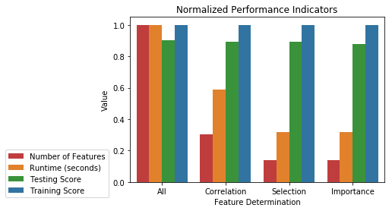
RFC Feature Set Performance Comparison
Number of features and runtime normalized
As number of features decreases, runtime decreases along with it
Performance decreases slightly, but not a large change

Slide 13
Feature Set Performance Comparison
Feature Set | All | Correlation | Selection | Importance
Number of Features | 561 (100%) | 171 (30.5%) | 77 (13.7%) | 77 (13.7%)
Runtime (in seconds) | 7.0122 (100%) | 4.1100 (58.6%) | 2.2421 (32.0%) | 2.2181 (31.6%)
Testing Accuracy | 90.0% | 89.3% | 89.1% | 87.7%
Training Accuracy | 100% | 99.9% | 100% | 99.9%

Slide 14
Feature Set Findings
All had most accuracy, longest runtime
Correlation much faster, similar accuracy
Selection performed best, efficient and accurate
Use this one to model
Importance set performed very poorly
Important to select intelligently while reducing dimensions

Slide 15
Exploring Different Models

Slide 16
Models Used
Determine most efficient model
Model using the Selection feature set
Use 5 different model types:
Random Forest Classifier
Extra Trees Classifier
K Nearest Neighbors Classifier
Support Vector Classifier
Lasso Logistic Regression

Slide 17
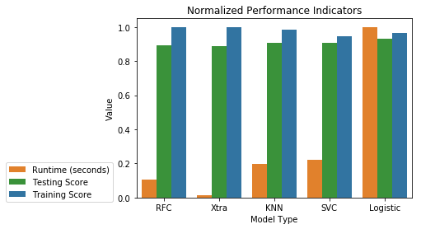
Normalized Performance Comparison
Only Runtime is normalized
As runtime increases, accuracy increases
As training score increases, testing score decreases

Slide 18
Model Performance Comparison
Model Type | Random Forest | Extra Trees | K Nearest Neighbors | Support Vector | Logistic
Runtime (in seconds) | 2.2869 | 0.5156 | 7.3311 | 8.8154 | 39.9392
Testing Accuracy | 89.1% | 88.9% | 90.6% | 90.8% | 92.9%
Training Accuracy | 99.9% | 100% | 98.3% | 94.6% | 96.5%
CV score (5 folds) | 88.2% | 86.7% | 88.7% | 90.8% | 89.8%

Slide 19
Model Type Findings
RFC performed well overall
Best if runtime is most important
XTC performed worst, overfit
KNNC not as good as other choices
SVMC performed best overfall
Best blend of accuracy and efficiency
Logistic most accurate, may have underlying problems
May be best if accuracy is most important

Slide 20
Conclusions

Slide 21
Overview
Data: Human Activity Recognition Using Smartphones
Feature Sets:
All, 561
Correlation, 170
Selection, 77
Importance, 77
Models Used: RFC, Xtra, KNN, SVC, Logistic

Slide 22
Findings
Removing features improves efficiency, low effect on accuracy
Best feature set for modeling is SelectFromModel
Best model: Support Vector Classifier
Best blend of efficiency and performance
Best CV score
RFC if efficiency is important

Slide 23
References
Dataset:
https://archive.ics.uci.edu/ml/datasets/human+activity+recognition+using+smartphones
Citations:
Davide Anguita, Alessandro Ghio, Luca Oneto, Xavier Parra and Jorge L. Reyes-Ortiz. Human Activity Recognition on Smartphones using a Multiclass Hardware-Friendly Support Vector Machine. International Workshop of Ambient Assisted Living (IWAAL 2012). Vitoria-Gasteiz, Spain. Dec 2012
Davide Anguita, Alessandro Ghio, Luca Oneto, Xavier Parra and Jorge L. Reyes-Ortiz. A Public Domain Dataset for Human Activity Recognition Using Smartphones. 21st European Symposium on Artificial Neural Networks, Computational Intelligence and Machine Learning, ESANN 2013. Bruges, Belgium 24-26 April 2013.
Jorge Luis Reyes-Ortiz, Alessandro Ghio, Xavier Parra-Llanas, Davide Anguita, Joan Cabestany, Andreu Català. Human Activity and Motion Disorder Recognition: Towards Smarter Interactive Cognitive Environments. 21st European Symposium on Artificial Neural Networks, Computational Intelligence and Machine Learning, ESANN 2013. Bruges, Belgium 24-26 April 2013.
http://www.ijirst.org/articles/IJIRSTV2I4024.pdf
https://www.profactor.at/en/research/industrial-assistive-systems/visual-computing/projects/instructme/
https://ieeexplore.ieee.org/document/7737171/
https://ieeexplore.ieee.org/abstract/document/4358934/

Slide 24
Appendix

Slide 25

Outcome Class Balance of Test Set
Testing Set is more balanced than training set
Not as important for modeling
18.2%
18.1%
16.8%
16.7%
16.0%
14.3%

Slide 26
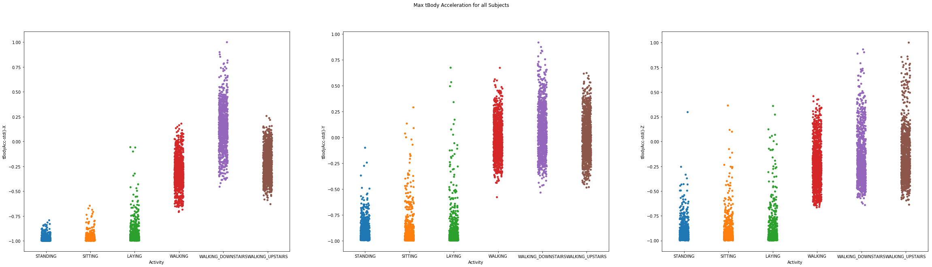
Passive vs. Active contd. 2
Plot shows standard deviation t-sensor acceleration for all activities
Passive activities tend to have more lower standard deviation
Passive less variable, Active more variable
SD Acceleration X
SD Acceleration Y
SD Acceleration Z

Slide 27
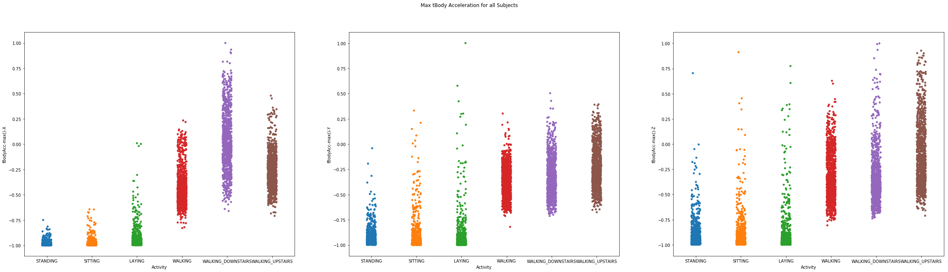
Passive vs. Active contd. 3
Plot shows max f-sensor acceleration for all activities
Passive activities tend to have more lower standard deviation
Passive less variable, Active more variable
SD Acceleration X
SD Acceleration Y
SD Acceleration Z

Slide 28

Passive vs. Active contd. 4
Plot shows standard deviation f-sensor acceleration for all activities
Passive activities tend to have more lower standard deviation
Passive less variable, Active more variable
SD Acceleration X
SD Acceleration Y
SD Acceleration Z

